Slide 1
Embedding / NL
8/12
윤혜진

Slide 2
ACK 2021
논문 제출 마감 2021/9/24
한국정보처리학회

Slide 3
ICONI
Abstract 9/15
Paper 9/30
Decision notification 10/15
Camera-ready paper 10/27
Registration 11/11
Conference 12/12~14

Slide 4
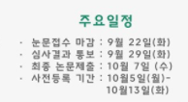
한글 및 한국어 정보처리 학술대회
(2020년 기준)

Slide 5
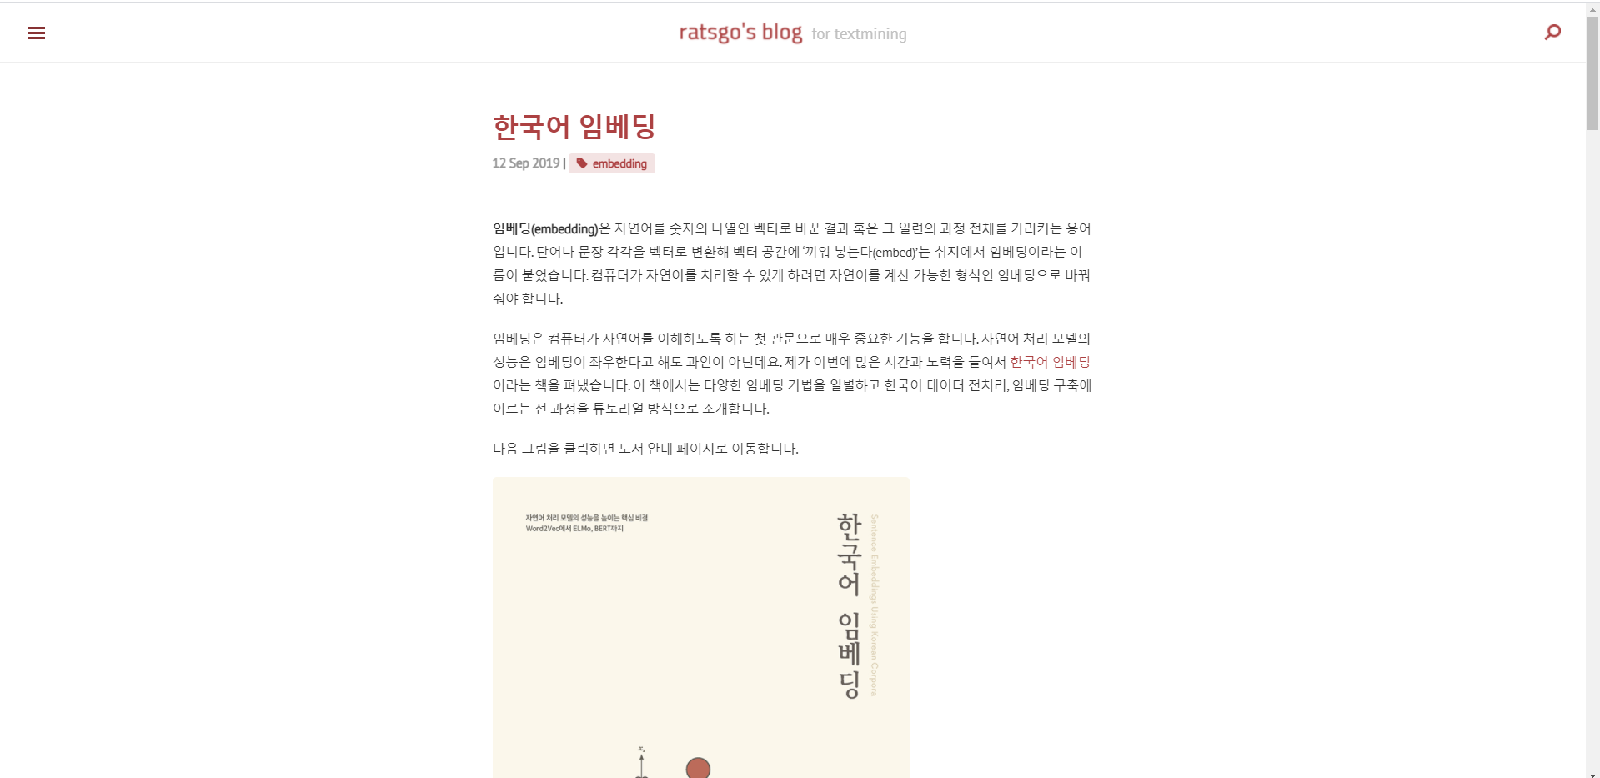
https://ratsgo.github.io/natural%20language%20processing/2019/09/12/embedding/

Slide 6




Embedding
Embedding
pretrain

Slide 7
Embedding
Embedding
model
Fine-tuning
문서 분류 과제에 맞게 업데이트
ㄴ 의미, 문법 정보

Slide 8
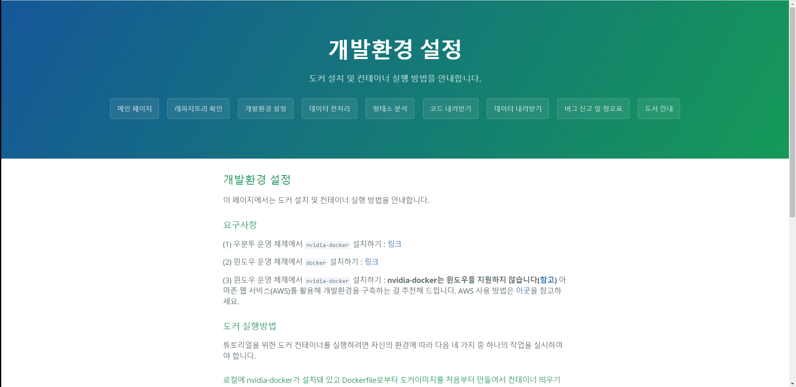

Slide 9
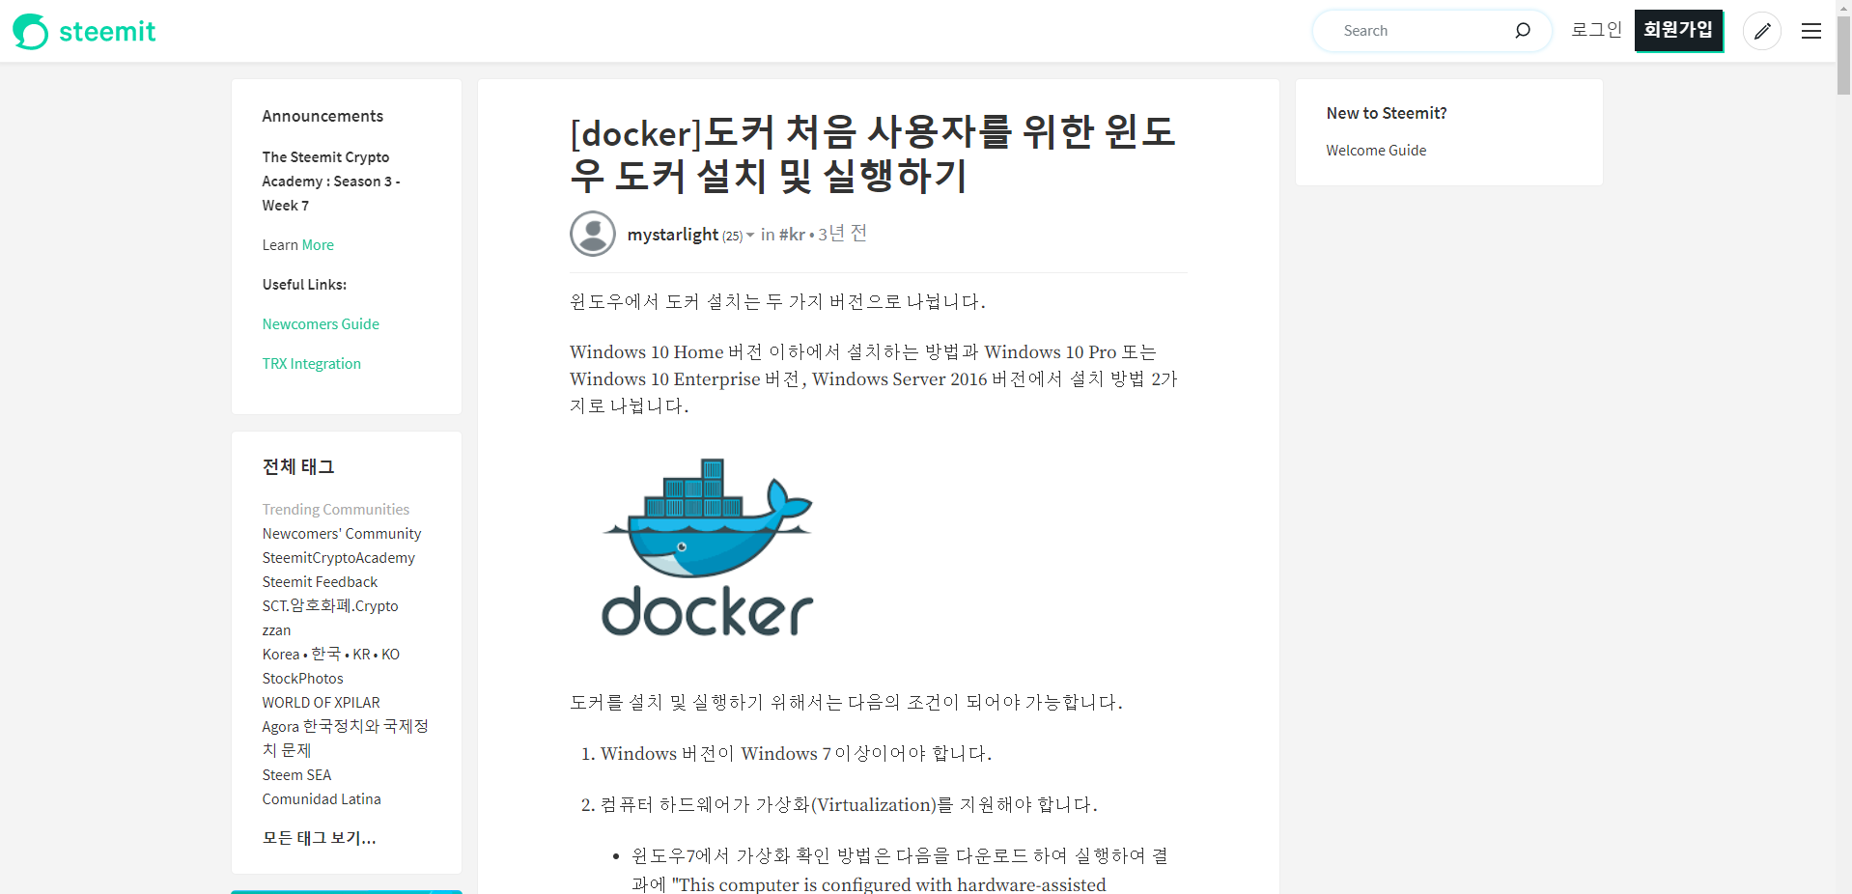

Slide 10
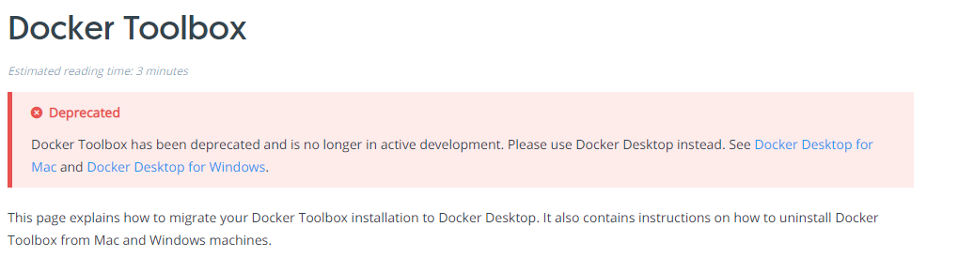
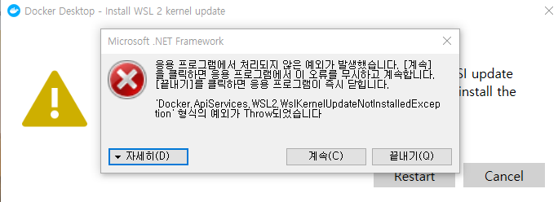

Docker 설치…
윈도우 포기
?

Slide 11


Slide 12
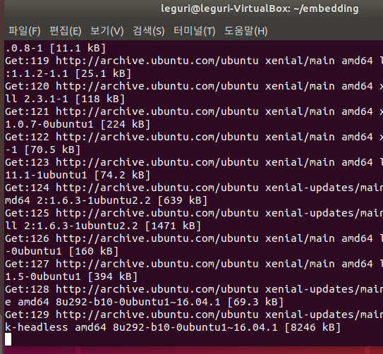
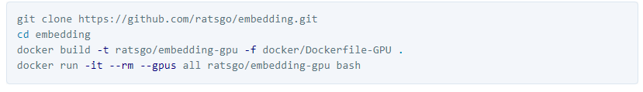
Docker 설치…

Slide 13
Docker 설치…
1h later, error occurred
apt-since (?)

Slide 14
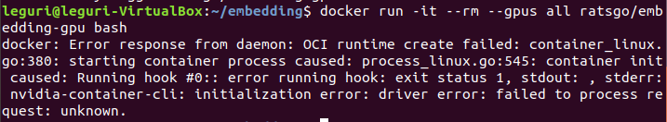
Docker 설치…

Slide 15

https://github.com/NVIDIA/nvidia-docker/issues/726

Slide 16
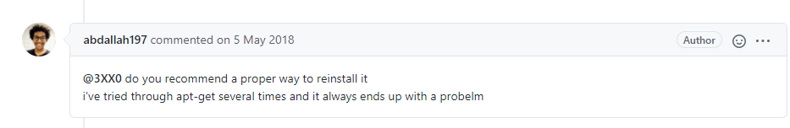

Slide 17
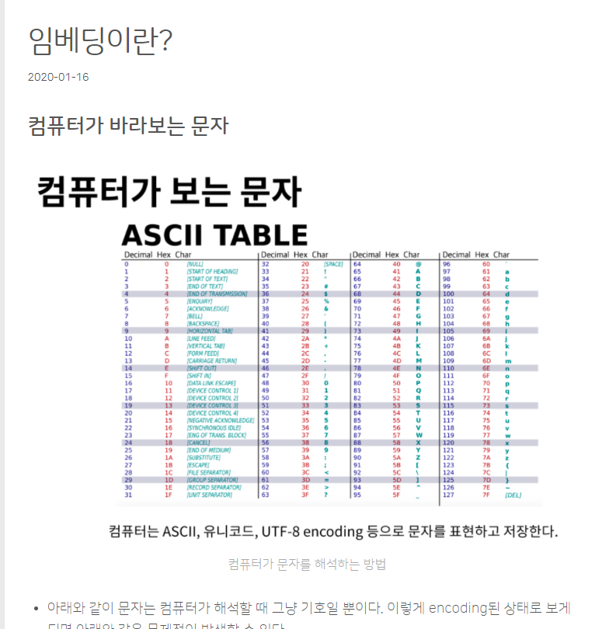
https://heung-bae-lee.github.io/2020/01/16/NLP_01/

Slide 18
0
0
1
…
0
0.4
0.7
…
-0.1
Word Embedding
Embedding vector

Slide 19
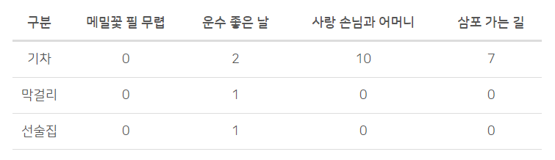

Slide 20
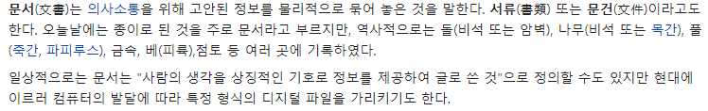
문서

Slide 21
문장

Slide 22
토큰

Slide 23
Corpus
Corpus : 임베딩 학습이라는 특정한 목적을 가지고 수집한 표본
Collection : corpus에 속한 각가의 집합
Vocabularay : Corpus내의 중복 없는 token들의 집합

Slide 24
역할 및 종류
역할
단어/문장 간 관련도 계산
의미적/문법적 정보 함축
전이학습
종류
행렬 분해
예측 기반
토픽 기반

Slide 25
자연어 -> 임베딩
벡터에 어떻게 의미를 녹여내는가?
1) BOW (Bag – of – Words) - 많이
2) Language model - 순서
3) Distribution hypothesis - 같이

Slide 26
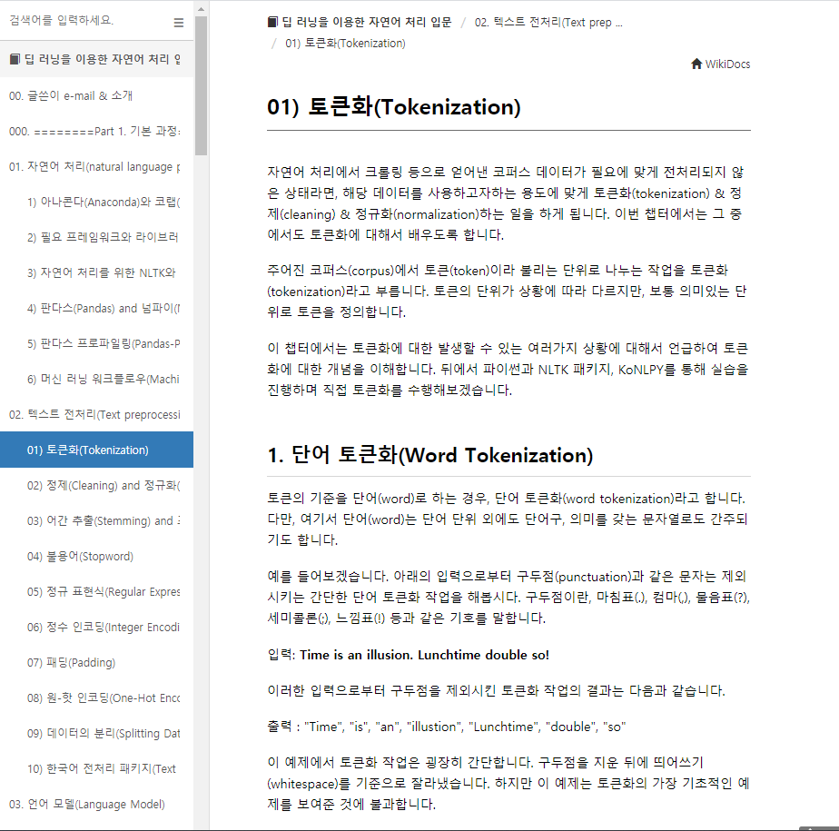
https://wikidocs.net/33274

Slide 27
text = "A barber is a person. a barber is good person. a barber is huge person. he Knew A Secret! The Secret He Kept is huge secret. Huge secret. His barber kept his word. a barber kept his word. His barber kept his secret. But keeping and keeping such a huge secret to himself was driving the barber crazy. the barber went up a huge mountain."

Slide 28
text = "A barber is a person. a barber is good person. a barber is huge person. he Knew A Secret! The Secret He Kept is huge secret. Huge secret. His barber kept his word. a barber kept his word. His barber kept his secret. But keeping and keeping such a huge secret to himself was driving the barber crazy. the barber went up a huge mountain."

Slide 29
text = "barber person. barber good person. barber huge person. Knew Secret! The Secret Kept huge secret. Huge secret. His barber kept his word. barber kept his word. His barber kept his secret. But keeping and keeping such huge secret himself was driving the barber crazy. the barber went huge mountain."

Slide 30
text = "barber person. barber good person. barber huge person. knew secret! the secret kept huge secret. huge secret. his barber kept his word. barber kept his word. his barber kept his secret. but keeping and keeping such huge secret himself was driving the barber crazy. the barber went huge mountain."

Slide 31
text = "barber person. barber good person. barber huge person. knew secret! the secret kept huge secret. huge secret. his barber kept his word. barber kept his word. his barber kept his secret. but keeping and keeping such huge secret himself was driving the barber crazy. the barber went huge mountain."

Slide 32
text = "barber person / barber good person / barber huge person / knew secret / secret kept huge secret / huge secret / barber kept word / barber kept word / barber kept secret / keeping keeping huge secret driving barber crazy / barber went huge mountain."

Slide 33
[['barber', 'person'], ['barber', 'good', 'person'], ['barber', 'huge', 'person'], ['knew', 'secret'], ['secret', 'kept', 'huge', 'secret'], ['huge', 'secret'], ['barber', 'kept', 'word'], ['barber', 'kept', 'word'], ['barber', 'kept', 'secret'], ['keeping', 'keeping', 'huge', 'secret', 'driving', 'barber', 'crazy'], ['barber', 'went', 'huge', 'mountain']]

Slide 34
('barber', 8) → 1
('secret', 6) → 2
('huge', 5) → 3
('kept', 4) → 4
('person', 3) → 5
('word', 2) → 6
('keeping', 2) → 7
('good', 1)
('knew', 1)
('driving’, 1)
('crazy', 1)
('went', 1)
('mountain', 1)

Slide 35
('barber', 8) → 1
('secret', 6) → 2
('huge', 5) → 3
('kept', 4) → 4
('person', 3) → 5

Slide 36
OOV
Out-Of-Vocabulary
[['barber', 'person'], ['barber', 'good', 'person'], ['barber', 'huge', 'person'],
1
5
1
6
5
1
3
5
barber | 1
secret | 2
huge | 3
kept | 4
person | 5

Slide 37
[[1, 5], [1, 6, 5], [1, 3, 5], [6, 2], [2, 4, 3, 2], [3, 2], [1, 4, 6], [1, 4, 6], [1, 4, 2], [6, 6, 3, 2, 6, 1, 6], [1, 6, 3, 6]]

Slide 38
Keras tokenizer
[[2, 6], [2, 1, 6], [2, 4, 6], [1, 3], [3, 5, 4, 3], [4, 3], [2, 5, 1], [2, 5, 1], [2, 5, 3], [1, 1, 4, 3, 1, 2, 1], [2, 1, 4, 1]]

